Slide 1
Community Connect – 2nd Review Meeting
Title: Lack of Proper Maternal Health Awareness in Semi Urban Areas
Date: 11th June 2025
Time: 03:00 PM – 04:15 PM
Presented by: Himani Sah
System id: 2023824909

Slide 2
Week 1 – Team & Community
Himani Sah – Field Lead (conducted all activities: community mapping, survey design, fieldwork and data analysis).
Community: Sundar Haraicha
Initial Observations: 1. Lack of maternal health literacy
2. Cultural stigma/taboos
3. Inadequate access to antenatal care

Slide 3
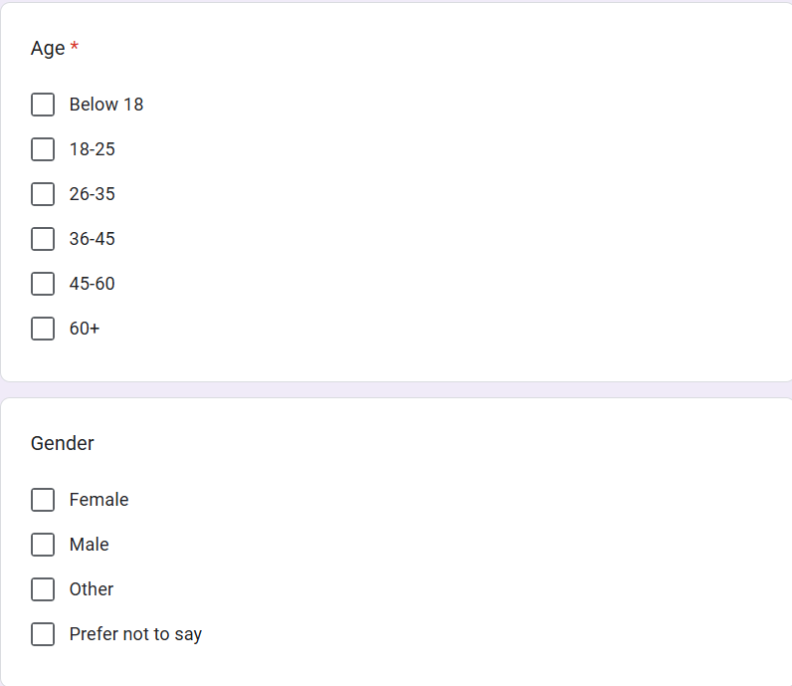
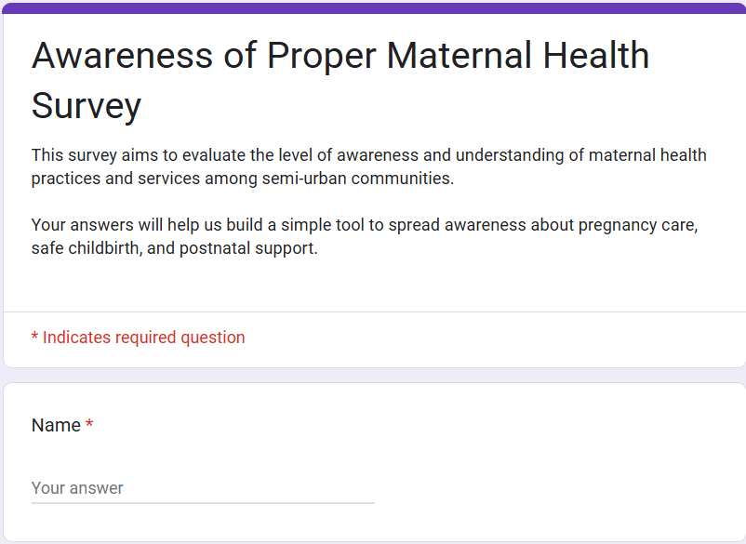
4. Final Survey Questionnaire

Slide 4
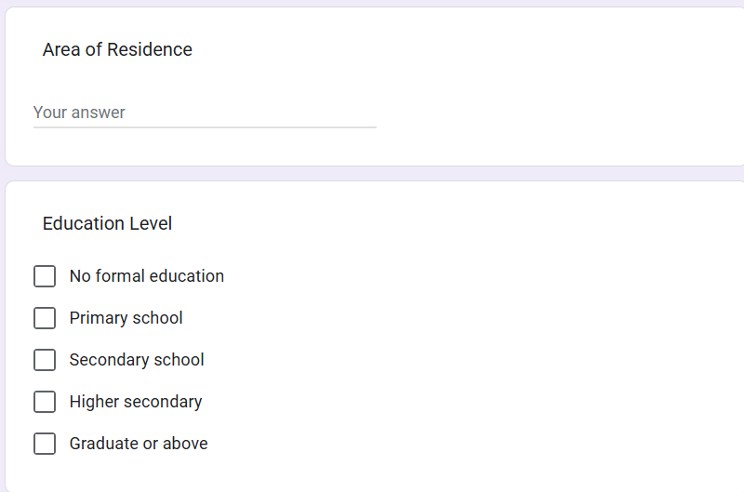
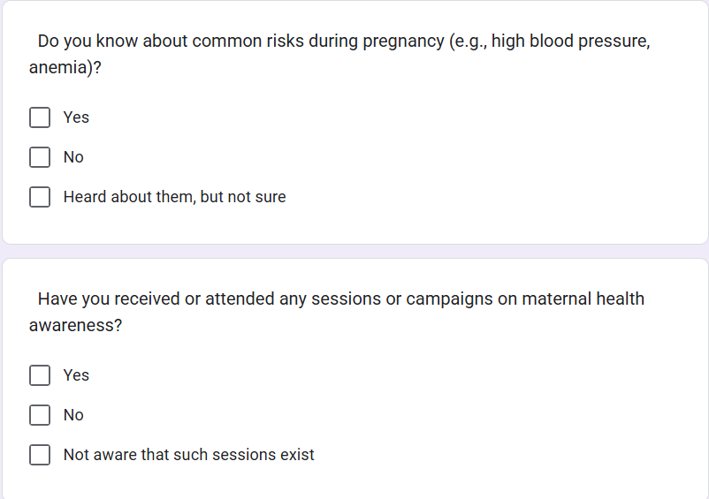
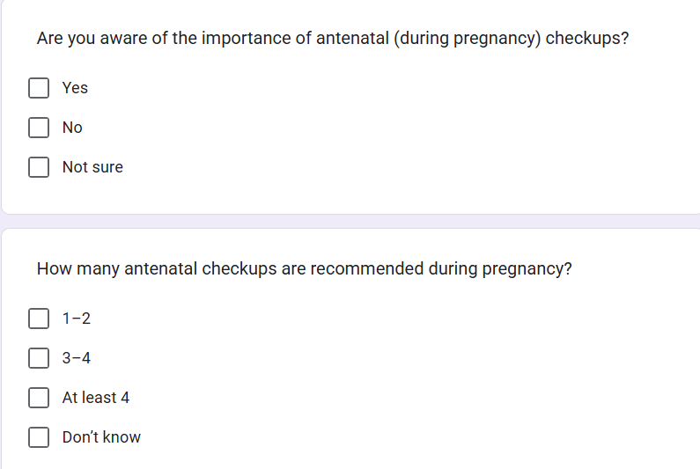
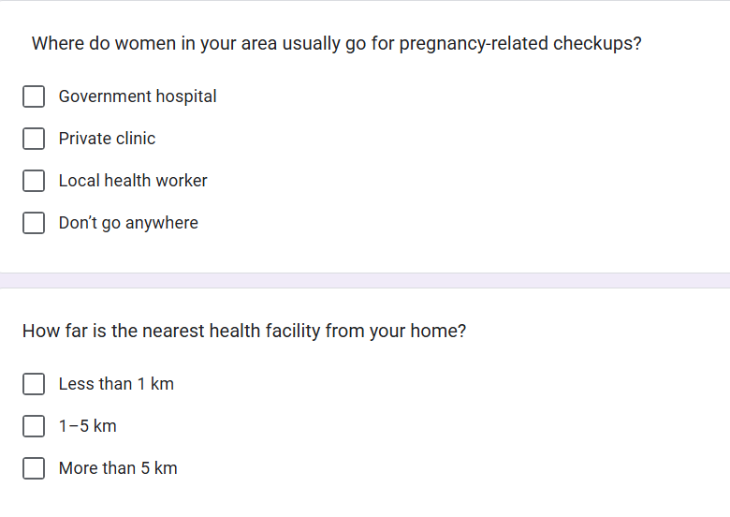

Slide 5
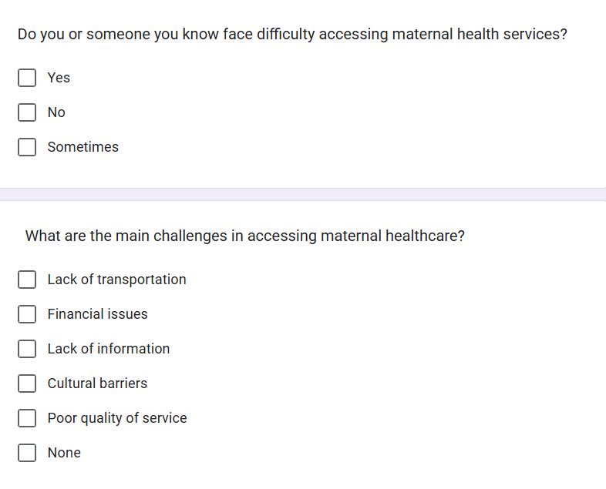
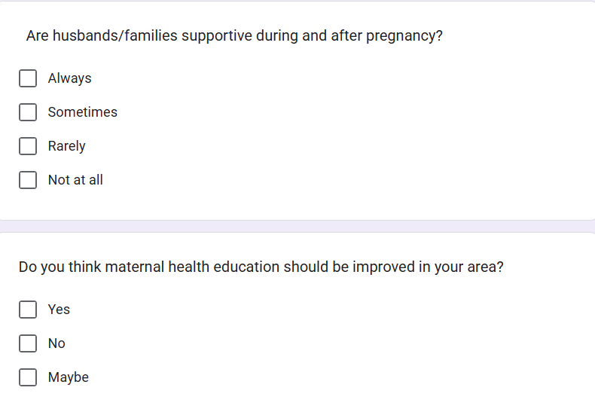
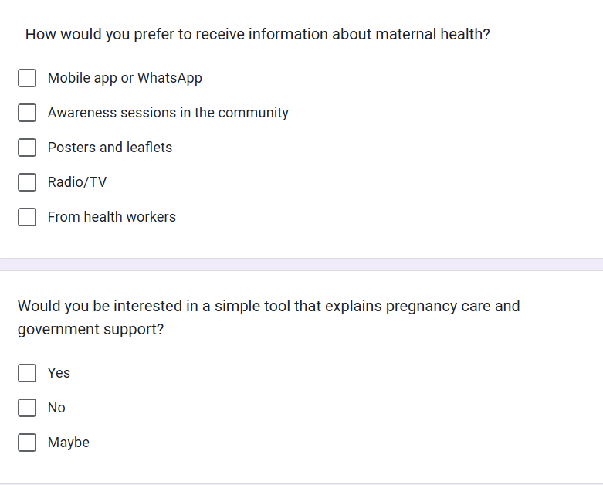
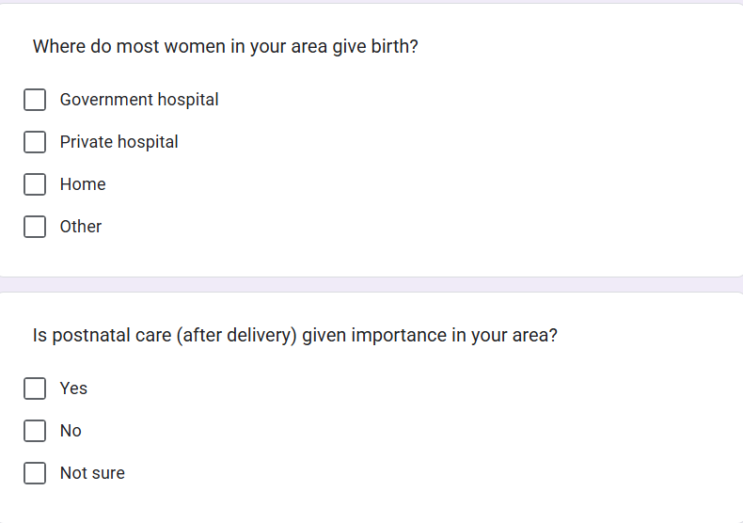
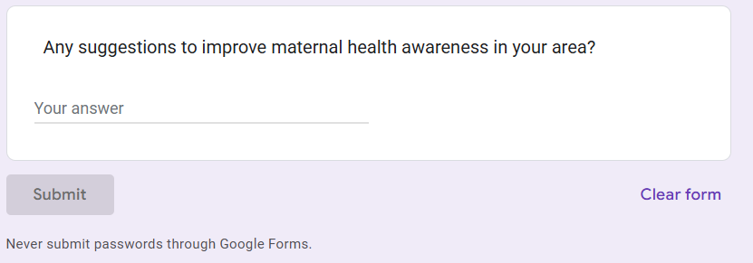

Slide 6
Week 2–3: Field Work – Visit 1
Number of residents surveyed: 25
Data collection method: In-person interviews and Google Forms.
Highlights: i) Strong willingness among young mothers
ii) Reluctance among elderly.

Slide 7
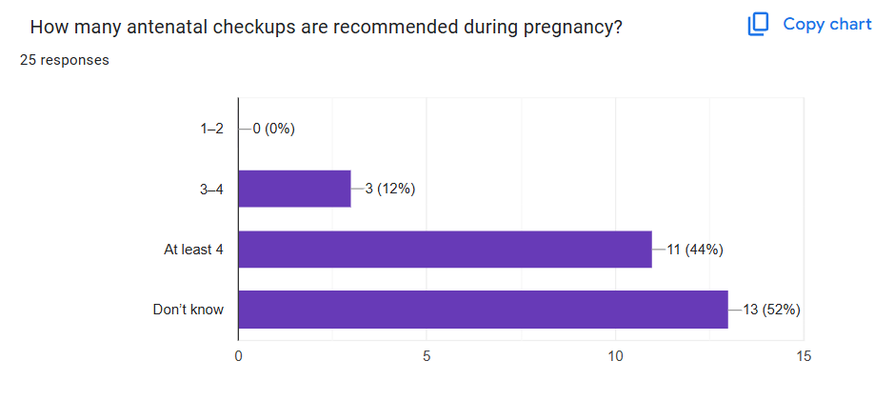
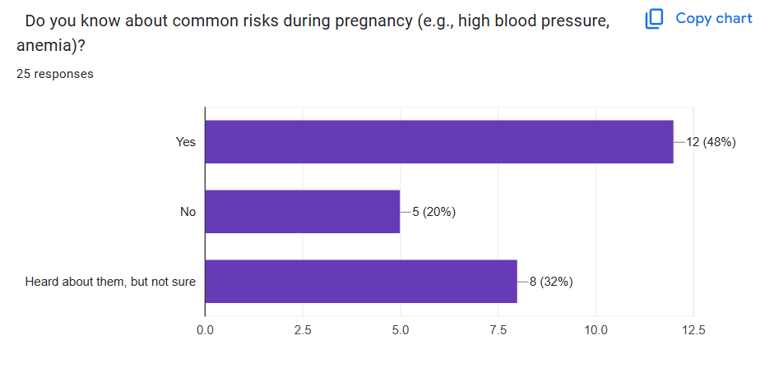
Week 2–3: Data Summary
a)
b)
Nearly half of the respondents are aware of common risks during pregnancy, but uncertainty remains high.
Majority of respondents are not aware of the recommended number of antenatal checkups.

Slide 8
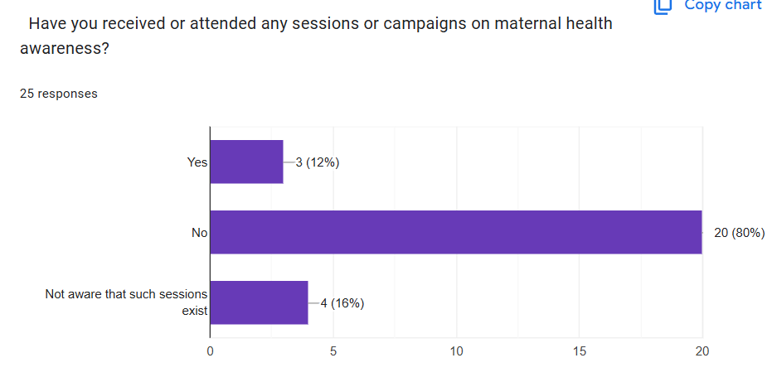
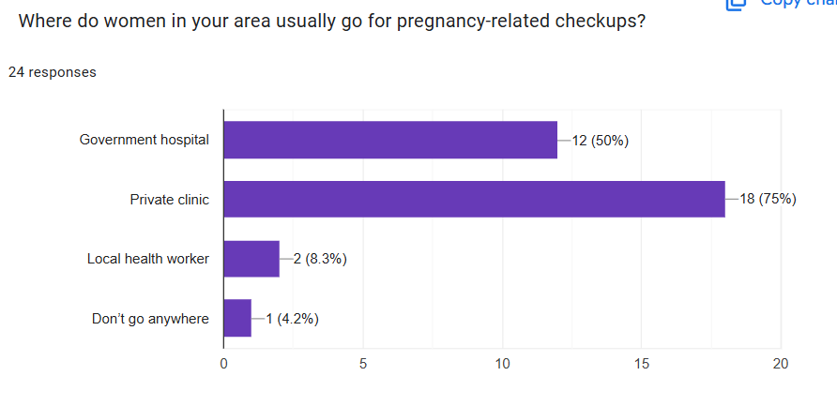
c)
d)
A majority of respondents (80%) have not received or attended any sessions or campaigns on maternal health awareness, indicating a significant gap in engagement or awareness.
Key Feedback:
“We hear about checkups but don’t know what to do or where to go.”
The majority of respondents (75%) prefer private clinics for pregnancy-related checkups, followed by government hospitals (50%), while local health workers (8.3%) and those not seeking care (4.2%) show minimal utilization.

Slide 9
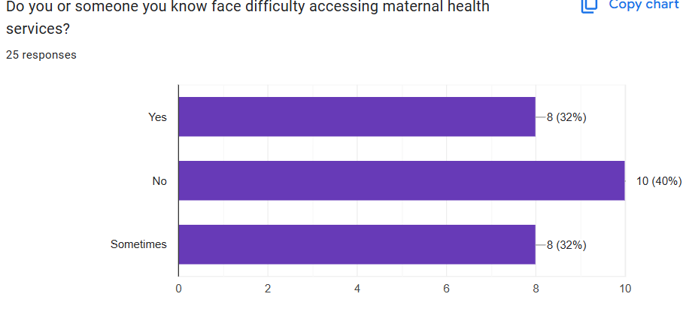
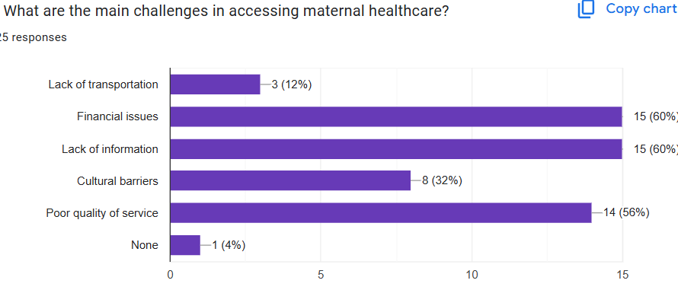
e)
f)
The majority of respondents (60%) identified financial issues and lack of information as the main challenges in accessing maternal healthcare, followed closely by poor quality of service (56%). Only 1% reported no challenges, while lack of transportation (12%) and cultural barriers (32%) were less cited.
The majority of respondents (40%) reported no difficulties accessing maternal health services, while 32% face consistent challenges and another 32% encounter occasional issues.

Slide 10
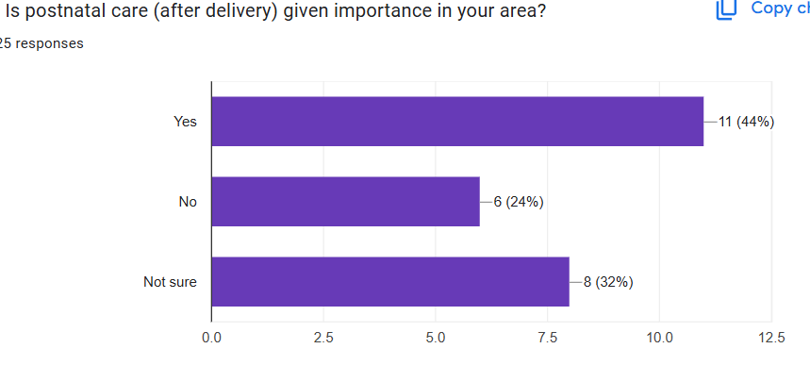
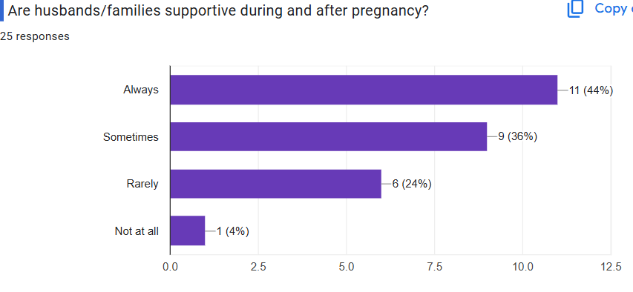
g)
h)
The majority of respondents (44%) reported that husbands/families are always supportive during and after pregnancy, while 36% said sometimes, 24% rarely, and only 4% noted not at all.
The majority of respondents (44%) believe postnatal care is given importance in their area, while 24% disagree and 32% are unsure, indicating varied perceptions.

Slide 11
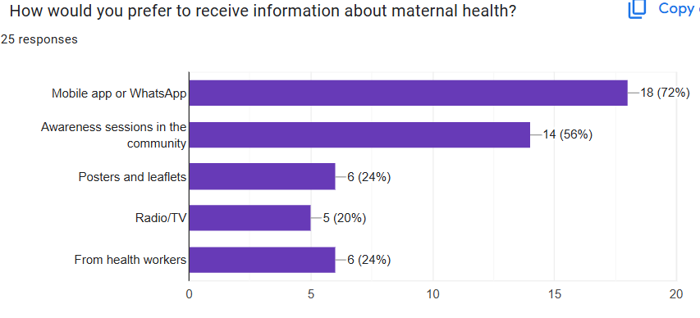
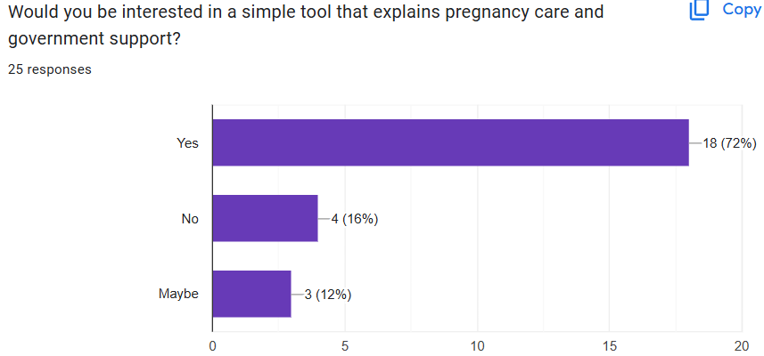
i)
j)
The majority of respondents (72%) expressed interest in a simple tool explaining pregnancy care and government support, while 16% showed no interest and 12% were undecided.
The majority of respondents (72%) prefer receiving maternal health information via mobile apps or WhatsApp, followed by awareness sessions in the community (56%), while posters/leaflets (24%), radio/TV (20%), and health workers (24%) are less favored.
.

Slide 12
Top 3 Issues Identified:
1. Lack of proper maternal health awareness
2. Limited understanding of available services and resources
3. Misinformation

Slide 13
Week 2–3: Community Visit 2
Validation of key problems done via follow-up interviews.
Community feedback: ‘Need someone to educate us on maternal health practices and resources.’– Local resident
Finalized Issue: Lack of proper maternal health awareness in semi-urban areas.

Slide 14
Problem Statement
Final Statement: Lack of Proper Maternal Health Awareness in Semi Urban Areas
Aligned SDG Goal: i) Goal 3 – Good Health and Well-being
ii) Goal 10 – Reduced Inequalities
Relevance: Low awareness leads to-
i) Missed maternal health opportunities
ii) Increased health risks
iii) Limited access to healthcare resources

Slide 15
Conclusion & Readiness
Summary: i) Community mapped
ii) Surveys conducted
iii) Issues validated
iv) Problem identified.
Next Steps: Design awareness tool (multilingual, visual, accessible).

Slide 16
Thank You!

